Slide 1
Plant Classification with Relative Angles
Term Project
Christopher Smith
December 03 2012

Slide 2
Outline
Concept
Data Set
Methodology
Training Set Creation
Test Set
Results
Only Scan Images
Scan and Scan-like Images
Conclusions

Slide 3
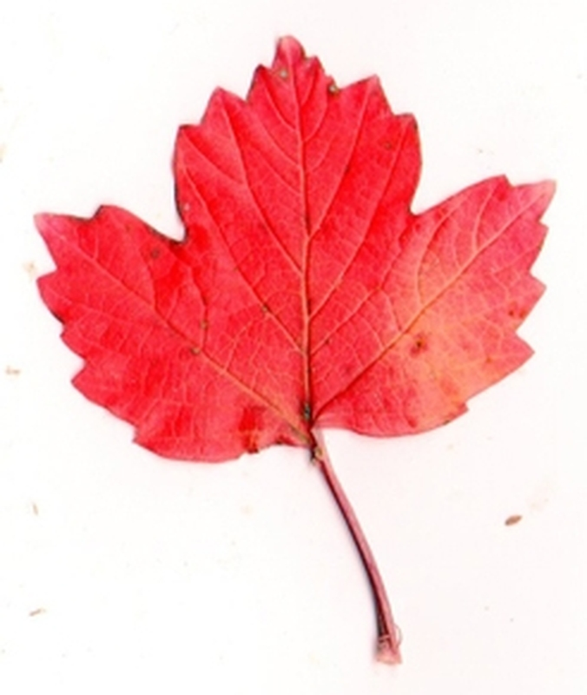
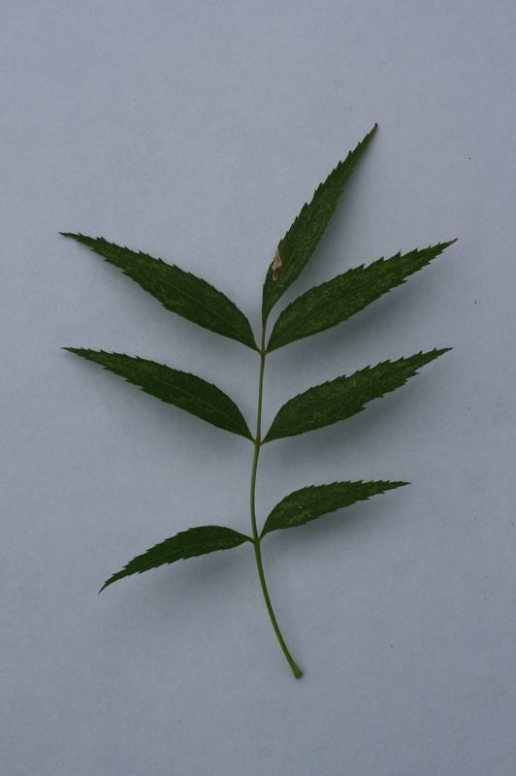
Concept
Classification of a leaf in an image based on the generalize shape of its class
Image Set: ImageCLEF2012 Plants

Slide 4


Methodology – Training Data
Segment and Clean image
Erode Image to find regions for each individual leaf
Create a mask and segment individual leaf

Slide 5






Methodology – Training Data
Leaves
After Applying
Masks
Much Closer To Their
Proper forms
Bottom Right Has
Almost No Shadow
Influence

Slide 6
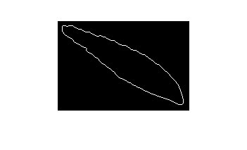


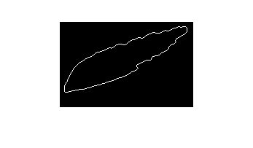


Methodology – Training Data
Leaf Edges
Map the Edges
By Tracing and
Noting The
Next Neighbor

Slide 7
Methodology – Training Data
Trace the edge
Applying these numbers to a string of values based on relation to X (eg. … 3 4 2 1 6 4 ...)
Subtract each number from the next to find the difference in angle
Dealing with special cases, such as 8-1 which is 1

Slide 8
Methodology – Training Data
Perform a Sequence Alignment on similarly classified number strings and find the average string as the representative case

Slide 9
Methodology – Test Data
Very similar to the training methodology
Instead of averaging the strings during the sequence alignment find the lowest cost (best score) compared to each plant class
Each region or leaf is classified independently and the mode of the result is the classification guess

Slide 10
Results – Scan & Scan-like
Images Tested: 88
Total Images: 2667
Correct Guesses: 3
Accuracy: 4.167%
Total Classes: 122
Result Run Time: 20+ hours @ 1.6GHz
Certain classifications appeared more often than they should
Better than random guessing
Definite Issues to address

Slide 11
Conclusions
Method too Complex to be used as a primary classifier
Computational issues
Many areas to improve accuracy and speed
Super Sets to reduce classes to match
Improved Sequence Alignment
Memory
Accuracy
Cost of skipping

Slide 12
References
[1] ImageCLEF Plant Data Set, http://imageclef.org/2012/plant
[2] tayyab's Image Segmentation Method, http://www.docstoc.com/docs/43883774/MATLAB-SOURCE-CODE-FOR-IMAGE-SEGMENTATION

